Slide 1
Keyboard Autocomplete & Autocorrect
Shide Pu, Shiwei Yu, Xiaomeng Chen, Hongyu Zhao

Slide 2

Agenda
Introduction & purpose
Dataset
Autocomplete
Doc2vec and Trie
Embedding match
LSTM
NNLM & n-gram
Text RNN with attention
Autocorrect
LSTM
Bayesian with BOW
Conclusion

Slide 3
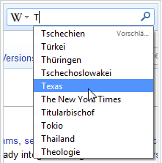
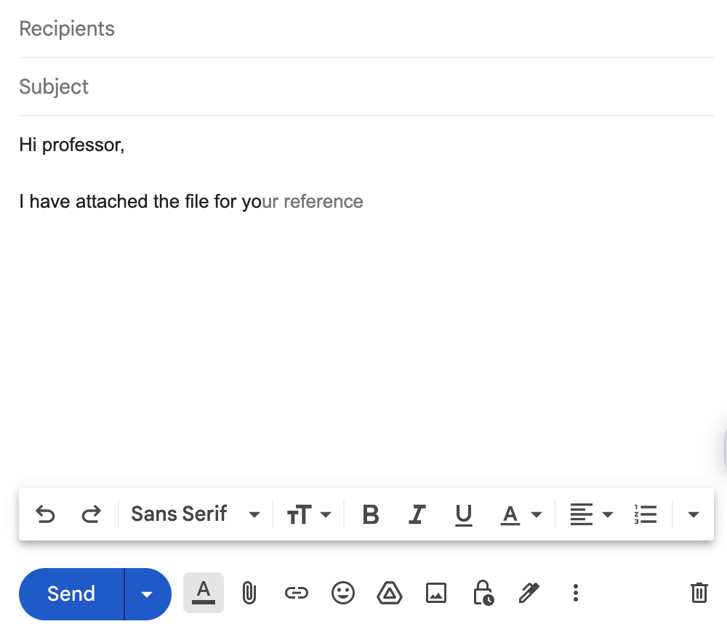
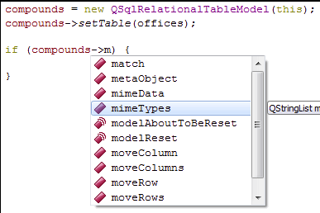
Usage by Software
In web browsers
In E-mail programs
In search engines
In code editors

Slide 4
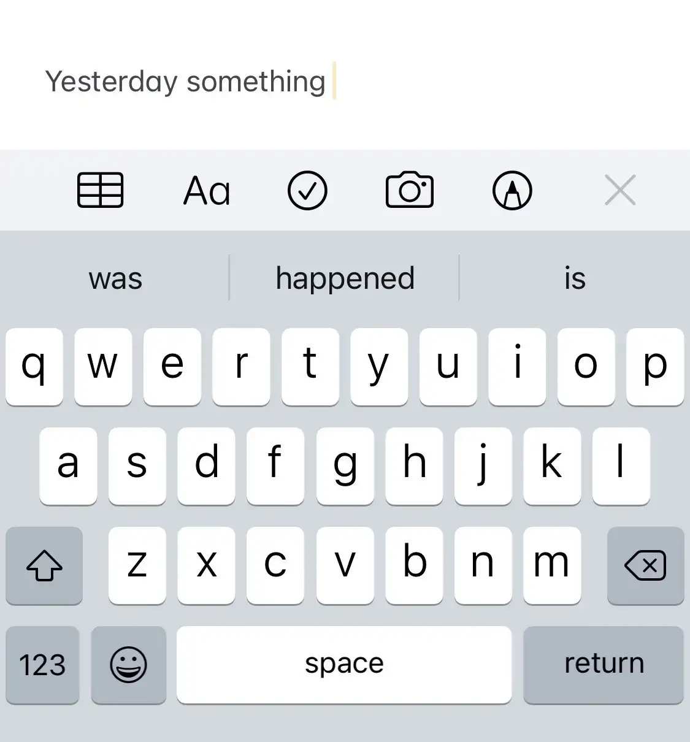
Introduction and Purpose
Autocomplete is a feature in which an application predicts the rest of a word a user is typing. In graphical user interfaces, users can typically press the tab key to accept a suggestion or the down arrow key to accept one of several.
Autocorrection is an automatic data validation function commonly found in word processors and text editing interfaces. Its principal purpose is as part of the spell checker to correct common spelling or typing errors, saving time for the user.
Purpose: To understand how it works, we will learn Natural Language Processing in this project and then we will use Python to build the autocomplete & autocorrection feature.

Slide 5
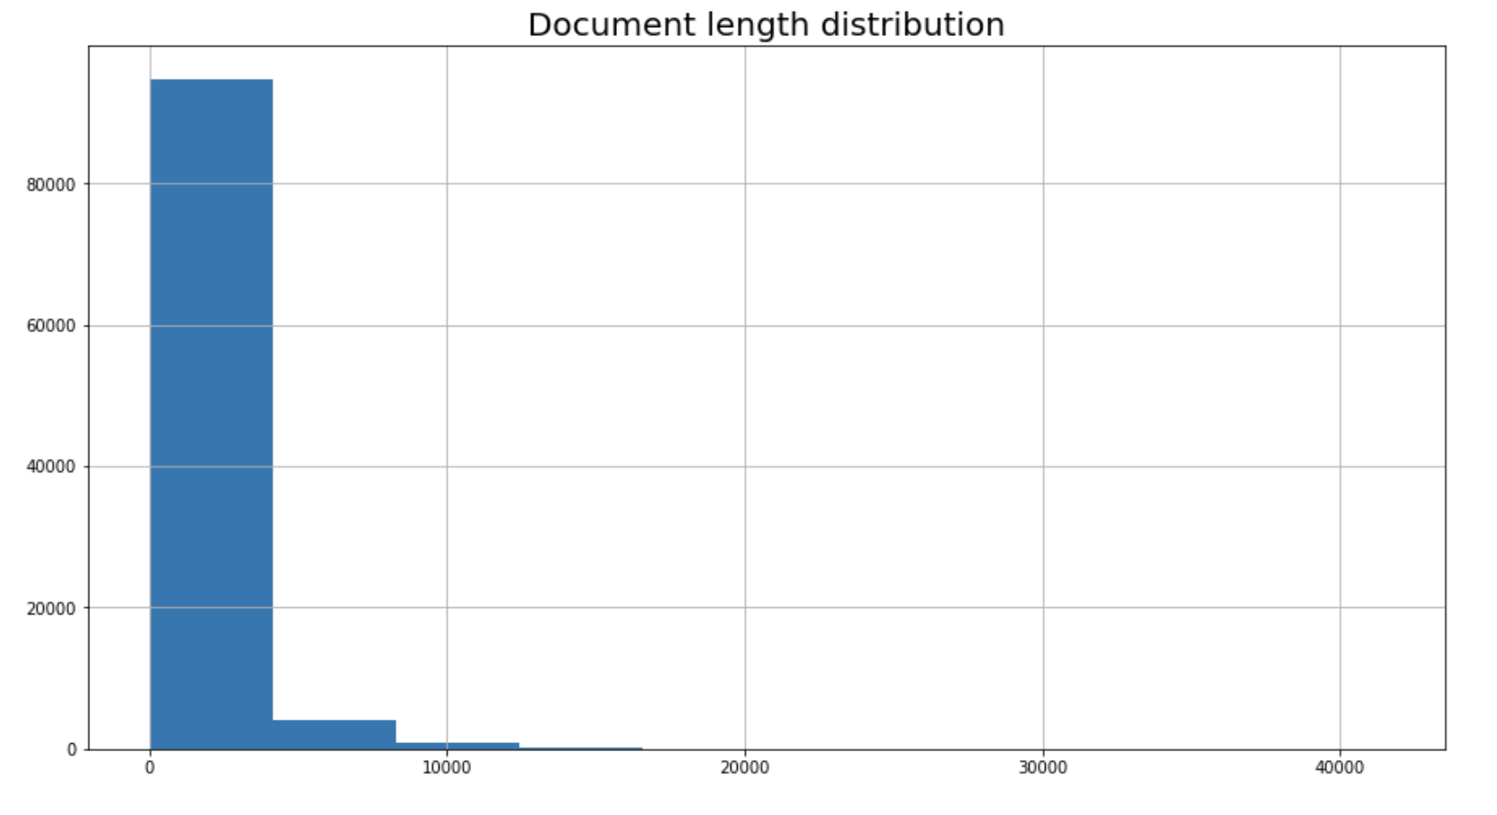
Dataset
This project will use Wikipedia data sets from Hugging Face which contain cleaned articles of all languages and are built from the Wikipedia dump with one split per language. Each example contains the content of one full Wikipedia article with cleaning to strip markdown and unwanted sections. The pre-processed English subset is around 20275.52 MB. We randomly select 100,000 documents, around 720mb, to train the model.

Slide 6
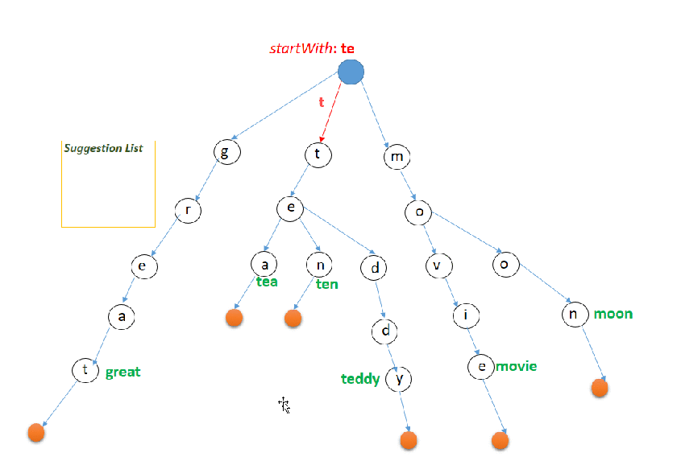
Doc2vec & Trie
Trie, aka digital tree or prefix tree
k-ary search tree
Search all strings with the input prefix
Links between nodes are defined by individual characters
Traversed depth-first search, O(n)
For example: if the Trie store {“tea”, “ten”, “teddy”, “movie”} and the user types in “te” then he must be shown {“tea”, “ten”, “teddy”}.

Slide 7
Doc2vec & Trie
Task: Find appropriate documents to generate a set of words to build a trie
Assume that similar documents are likely to contain similar word patterns.
Find similar training documents to the input document
Doc2vec
Vector size = 32
Store word embedding in memory. Limit the size of the model

Slide 8
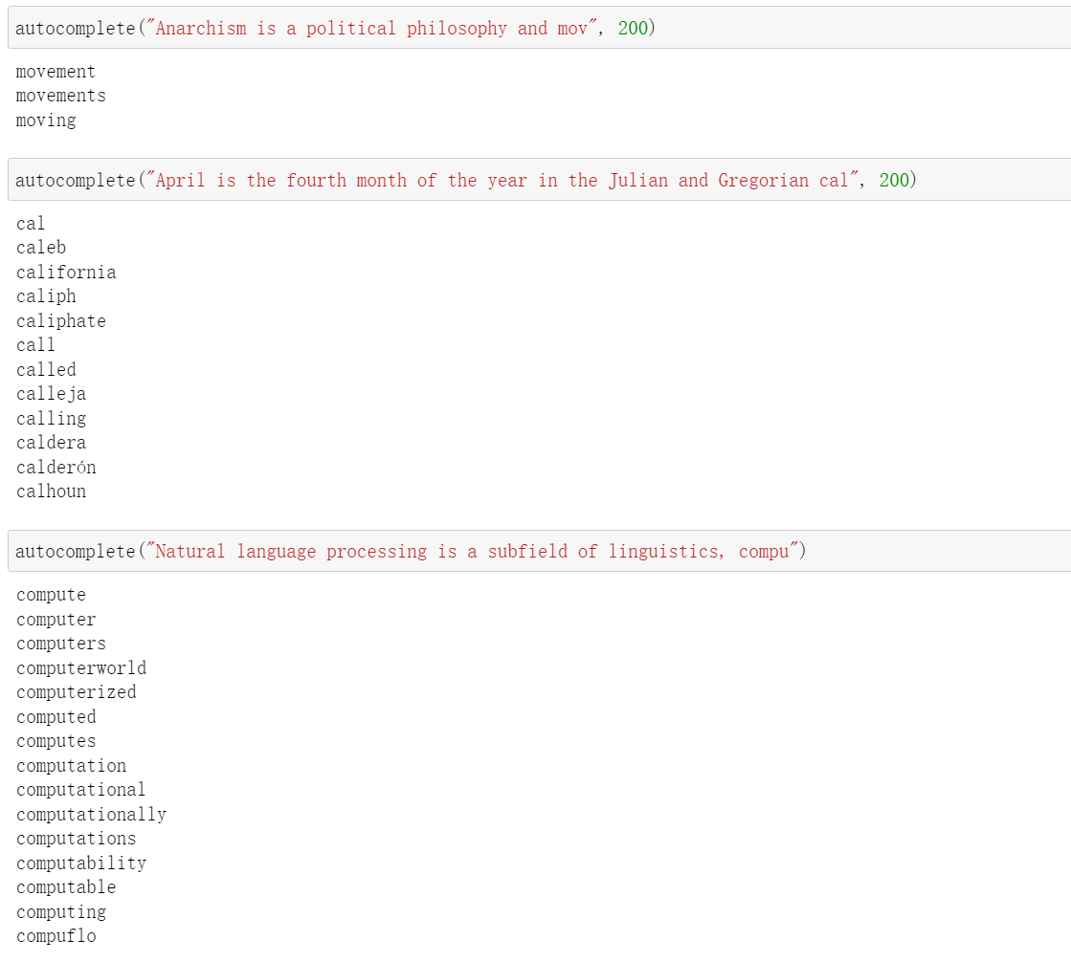
Doc2vec & Trie - Result

Slide 9
Doc2vec & Trie - Summary
Advantage:
Prediction is very Fast
Easy to implement
Disadvantage:
Simple listing of all possible words without ranking
Depends on the performance of Doc2vec
May not find result
Model size is large
32 vector size → 170 MB
128 vector size → 800 MB

Slide 10
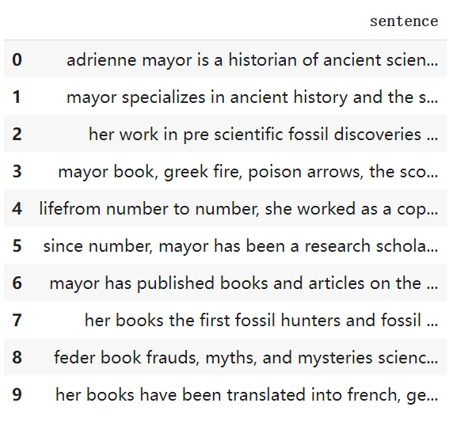
Embedding Match
Split 20000 documents into sentences
About 1.1 million sentences
140 MB

Slide 11
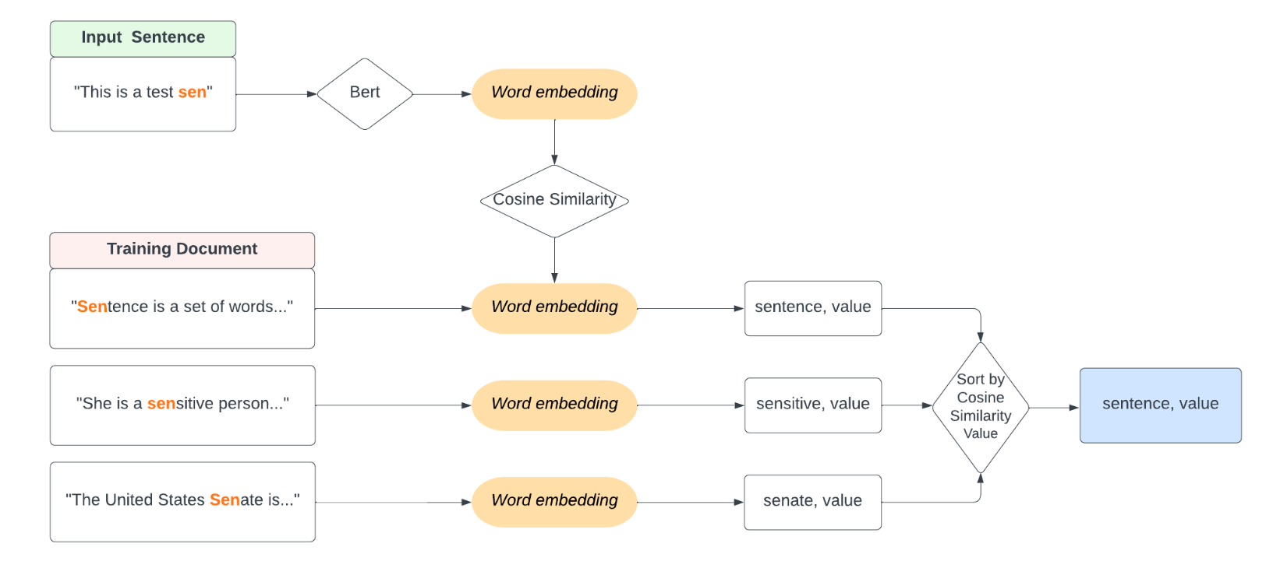
Embedding Match - Process

Slide 12
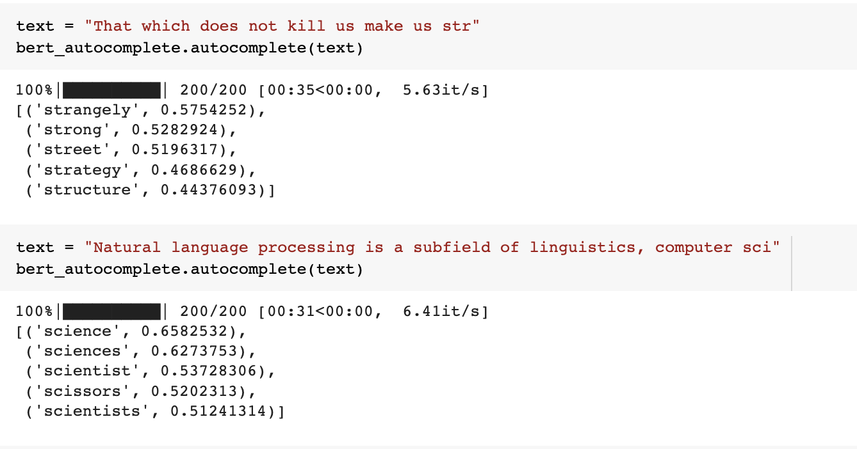
Embedding Match - Result
Very slow!!!
About 40 seconds to search 200 documents

Slide 13
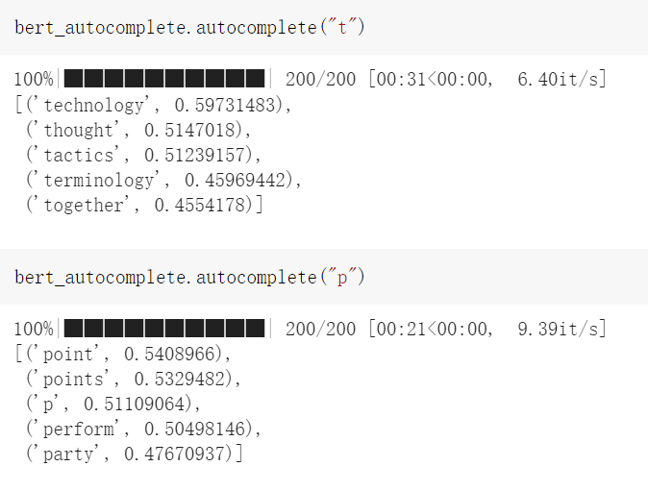
Embedding Match - Result
Able to complete single character

Slide 14
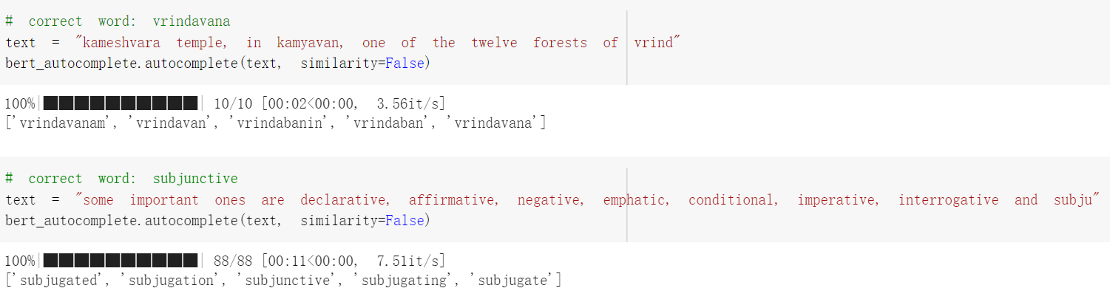
Embedding Match - Edge Case
If the word is not contained in the tokenizer, we cannot get word cosine similarity
“vrindavana”, “subjunctive”
Collect words from training documents as result

Slide 15
Embedding Match - Summary
Advantage:
Prediction results are good
Complete input sentences with any lengths
Disadvantage:
May not have result
Slow, a single prediction takes about 40 seconds in Colab
To speed up prediction, cache word embeddings into memory
Require a large amount of memory
1,000,000 × 15 × 768 × 4 bytes = 43 GB

Slide 16
LSTM
Receive incomplete words as input and predict the next character
Bag of characters : [' ', '!', ',', '.', '?', 'a', 'b', 'c', 'd', 'e', 'f', 'g', 'h', 'i', 'j','k', 'l', 'm', 'n', 'o', 'p', 'q', 'r', 's', 't', 'u', 'v', 'w', 'x', 'y', 'z']
26 English characters, 4 punctuation marks, 1 white space
Dimension of character is 31
White space is very important:
Indicates end of a word
Model continually makes predictions until hits white space

Slide 17
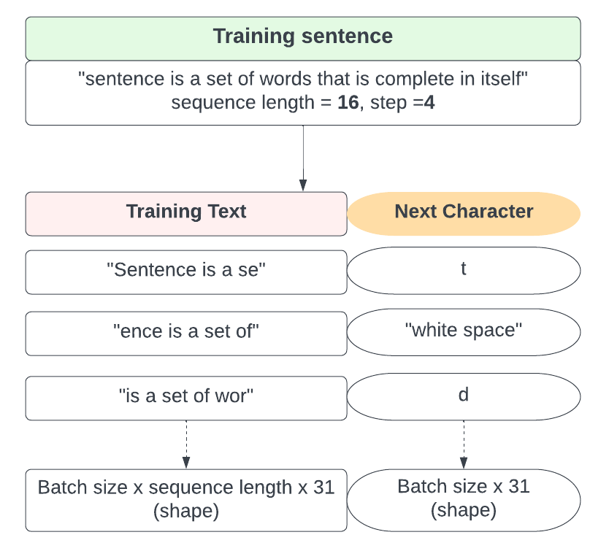
LSTM - Generate Training Data
Training documents: fixed length sequences
sequence_length: length of training sequence
step: number of characters jump between two sequences
sequence_length=32, step=4
Prediction documents: next characters

Slide 18
LSTM - Model Selection
LSTM Structure | Training Loss, Accuracy | Validation Loss, Accuracy
1 layer LSTM | 1.5361 , 0.5478 | 1.8017 , 0.4805
3 layer LSTM | 1.4943 , 0.5563 | 1.5986 , 0.5293
5 layer LSTM | 1.5511 , 0.5456 | 1.6383 , 0.5117
1 layer Bidirectional LSTM | 1.5648 , 0.5383 | 1.6199 , 0.5248
2 layer Bidirectional LSTM | 1.5076 , 0.5550 | 1.6408 , 0.5246
1 layer of LSTM and 1 layer Bidirectional LSTM | 1.4854 , 0.5606 | 1.6576 , 0.5084
Notes:
In the step of model selection, We tried 6 different layers of LSTM models.
Then, we calculated and compared the loss function and accuracy of training set and validation set.
Here we can find that the two values of 3 layer LSTM are the closest, so it performs best among the listed 6 models.

Slide 19
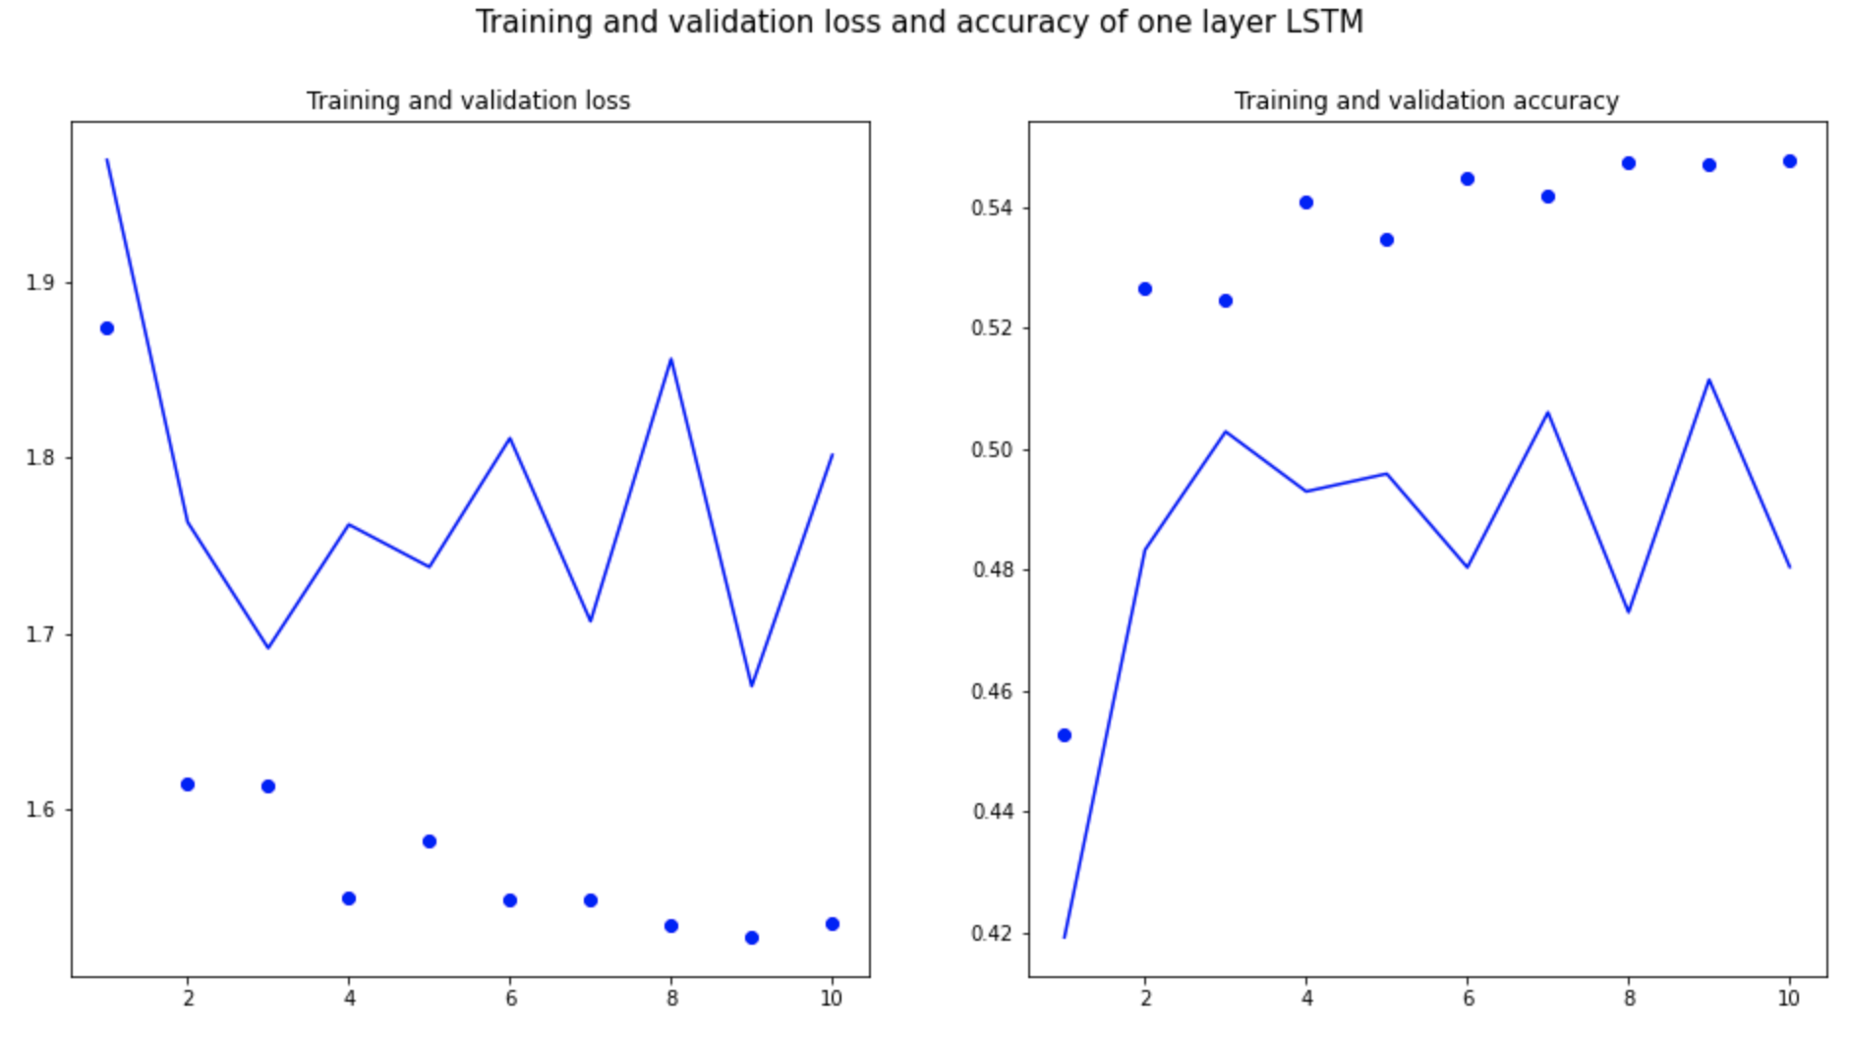
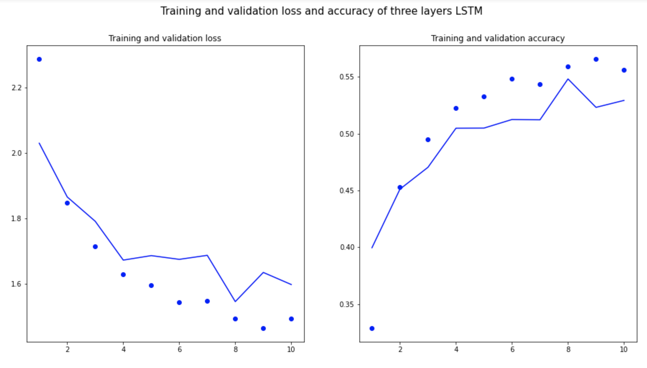
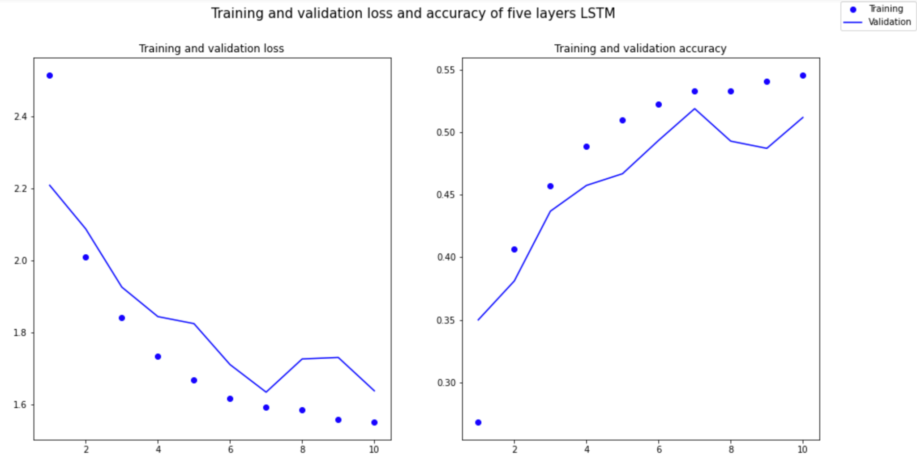
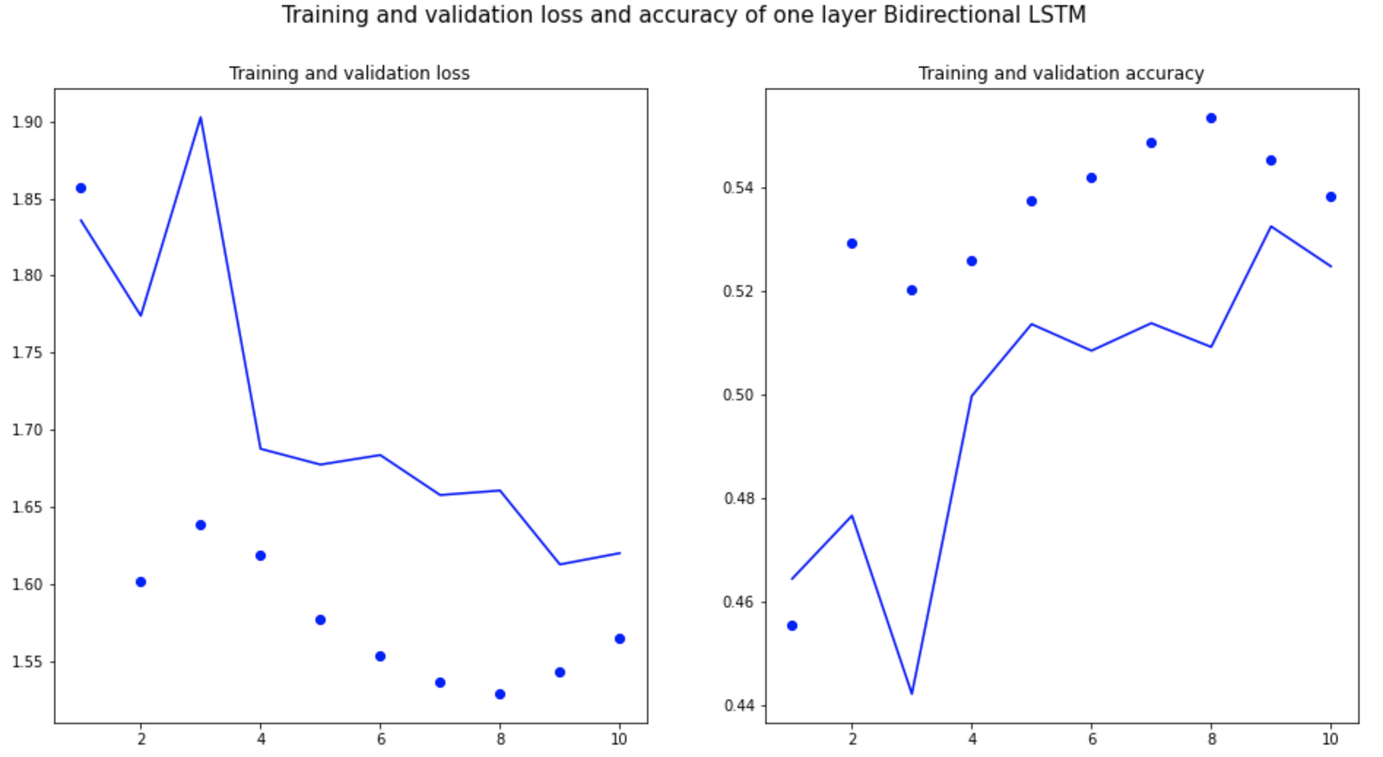
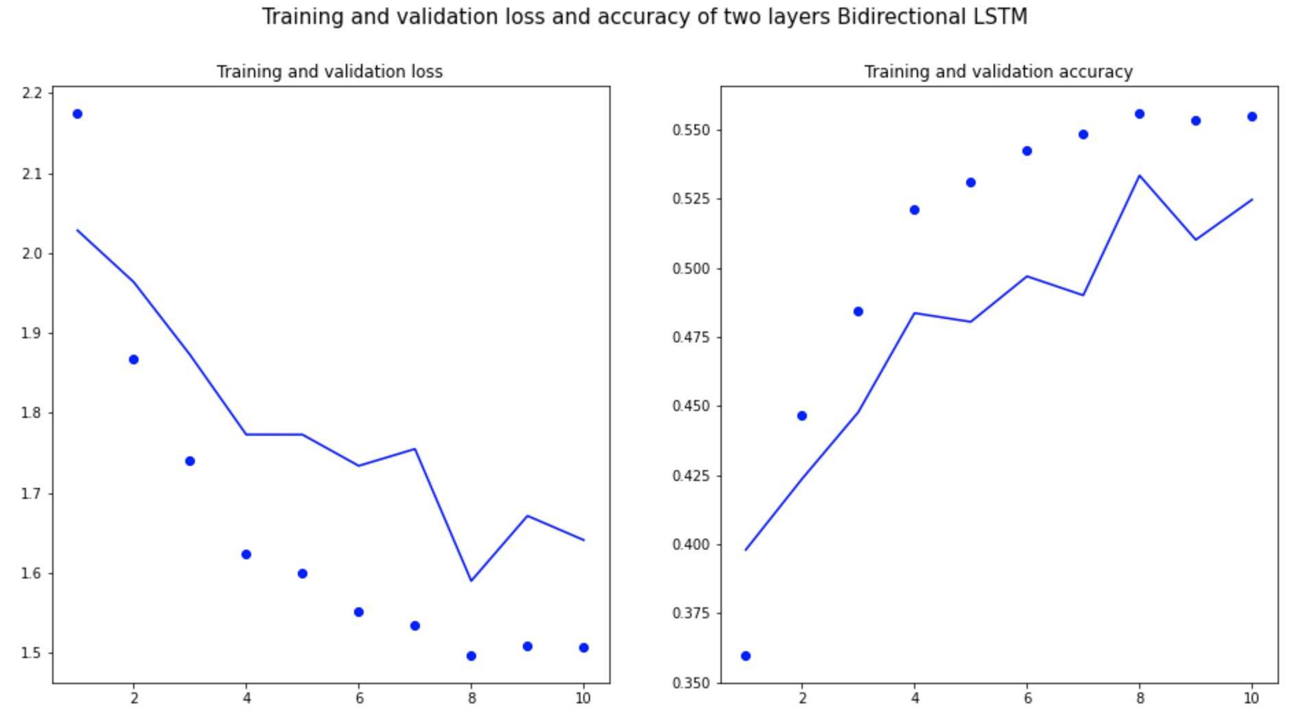
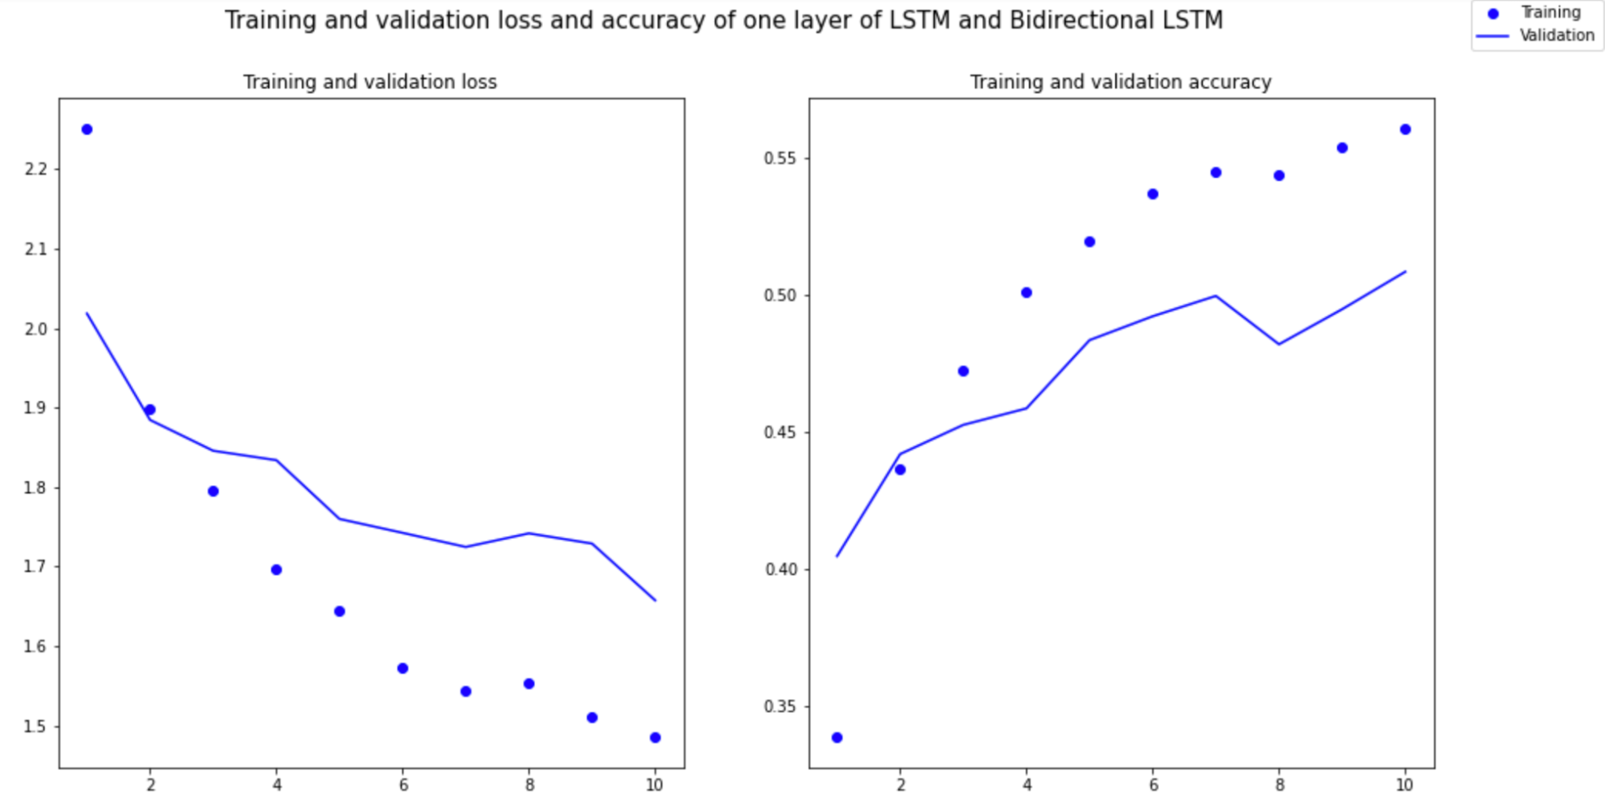
LSTM - Model Selection
Notes:
From the 6 plots here, we can come to the same conclusion. We can also see that the left one is the learning curve of the loss function,
and the right one is the learning curve of the accuracy rate.
The two curves are closer than other models, so it is verified again that the 3-layer LSTM is the most suitable model.
From the trend of the two curves, they are also gradually approaching, which indicates that the performance of the model is better.

Slide 20
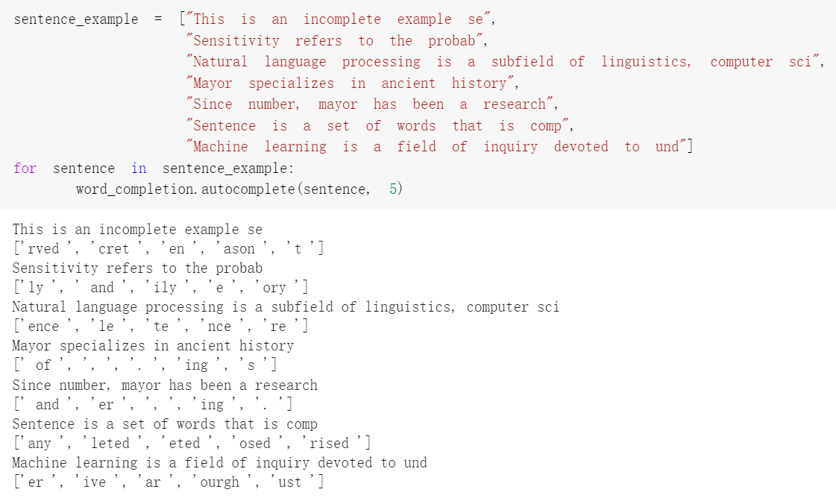
LSTM - Result
Notes:
Here is the test result of LSTM. We took the top 5 characters with the highest probability.
From the output results, the model works well.

Slide 21
3-layer LSTM - Summary
Advantage:
Training is efficient
Five layer LSTM takes 10 minutes
Definitely generate prediction results
Effectively complete words based on prefix
Some ability to predict next words
Disadvantage：
If the input sentence is less than the sequence length, predictions are bad
The input sentence can only contains characters in the set

Slide 22
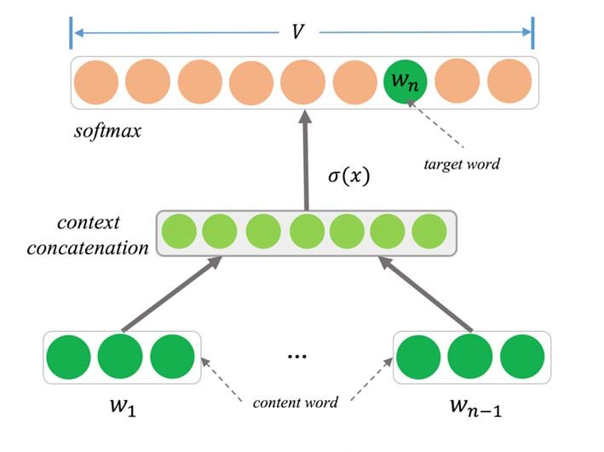
NNLM & ngram
In the two models of Neural Network Language Model (NNLM) and n-gram, I perform word embedding layer followed by fully connected layer and activation function.
Due to its fully connected characteristics, the parameters of the general fully connected layer are also the most.
Then, we take the classification with maximum probability for all softmax function.

Slide 23
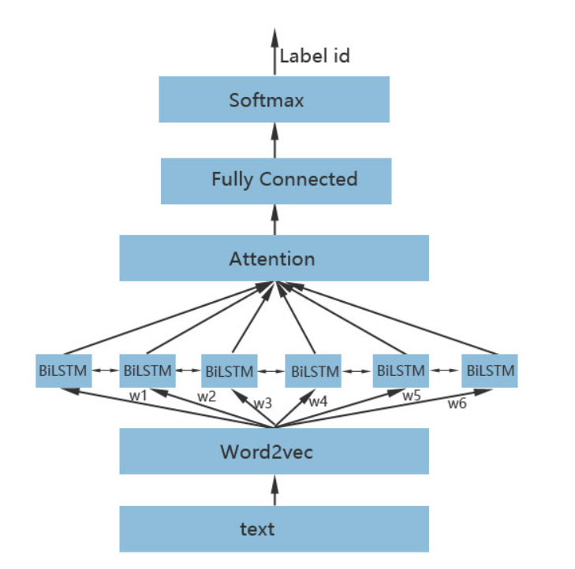
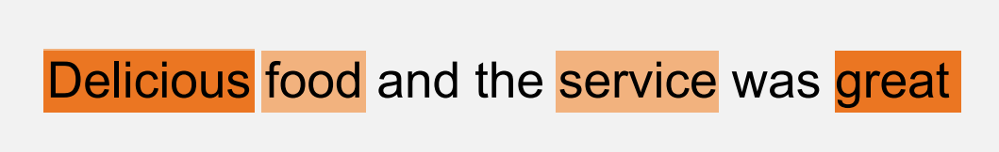
Text RNN with attention
We connect the TextRNN model to a layer of RNN after the embedding layer, and then classify it.
It is worth noting that we also introduced the concept of attention, which is to add a layer of attention to the TextRNN model.
Attention is similar to human observation of other things. When people observe something, they generally do not treat it as a whole, but tend to selectively obtain important parts according to their own needs.

Slide 24
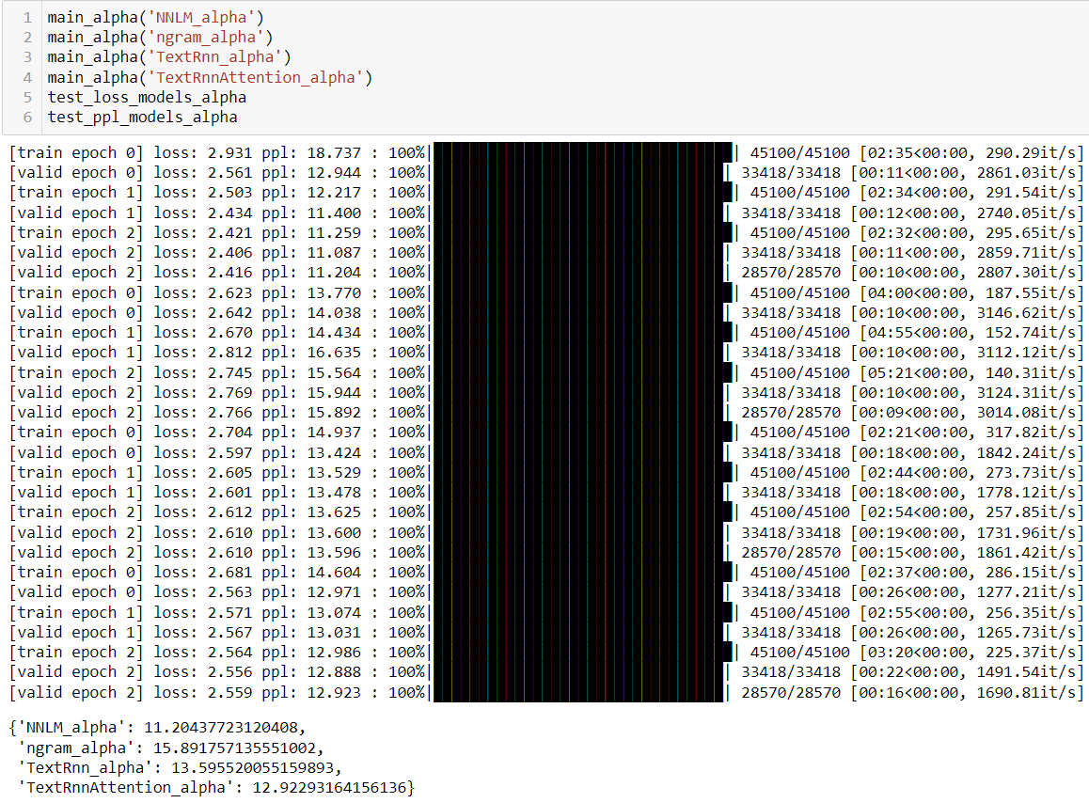
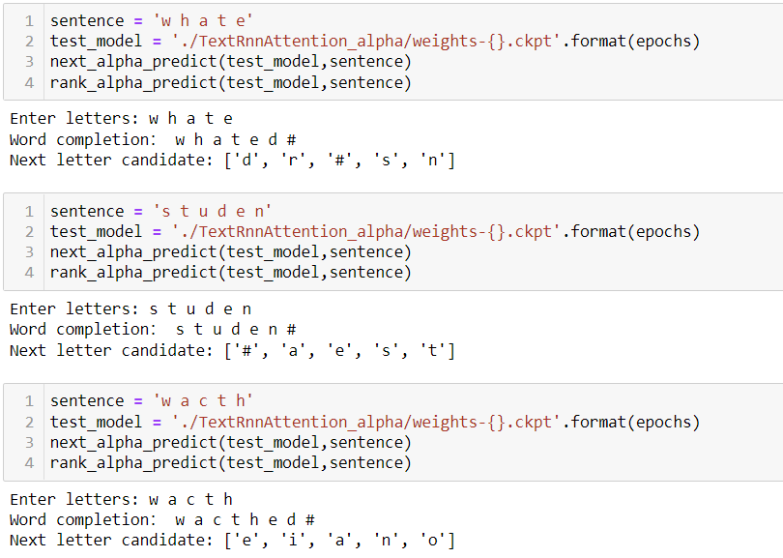
Results of 4 models in characters
Since 26 characters are compared to words, the amount of calculation will be much less.
Considering the CPU of the device, we only selected a small part of the data for training. Characters have higher accuracy than words.

Slide 25
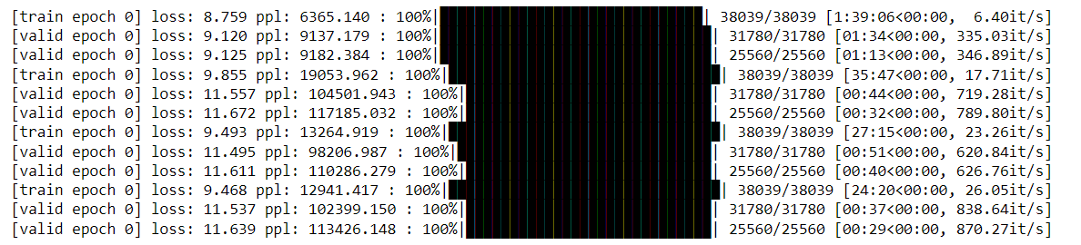
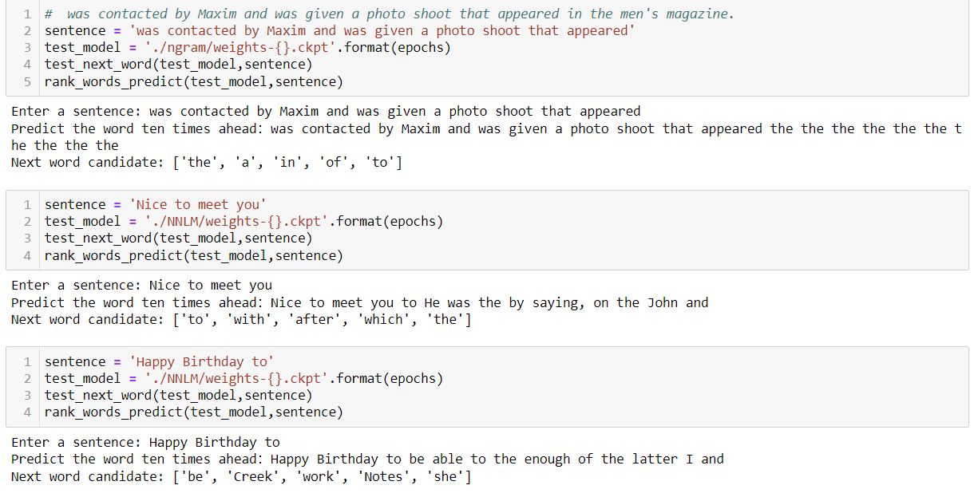
Results of 4 models in words
This can be seen from the perplexity. The lower the perplexity index, the more smooth and continuous the sentence.
The words part is very poor due to the small amount of training data.

Slide 26
NNLM & ngram & TextRNN with Attention - Summary
NNLM & ngram
Advantage:
It contains all the information that the first N-1 words can provide, which have strong constraints on the current word.
Disadvantage:
It requires a considerable amount of training text to determine the parameters of the model.
When N is large, the parameter space of the model is too large.
TextRNN with Attention
Advantage:
Visually give the contribution of each word to the result
Disadvantage:
cannot be directly observed, especially when analyzing badcase

Slide 27
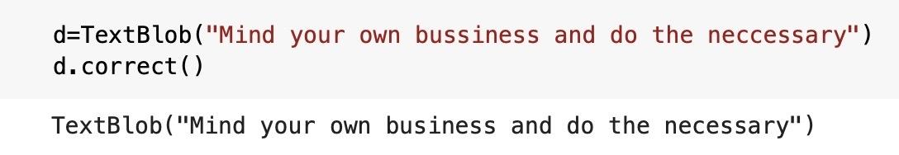
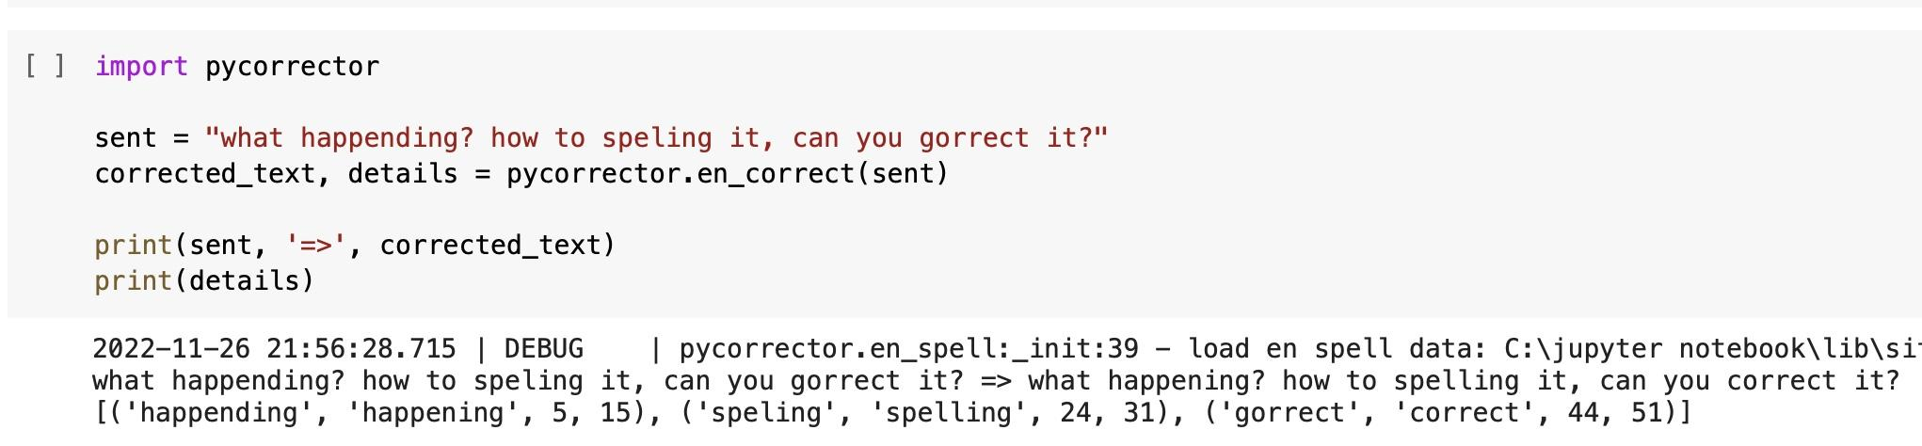
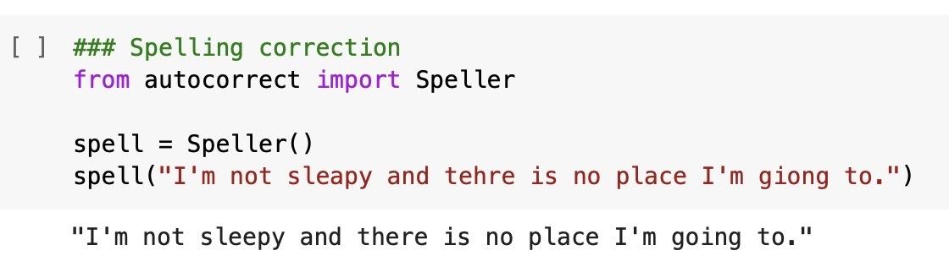
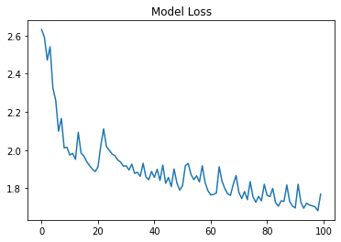
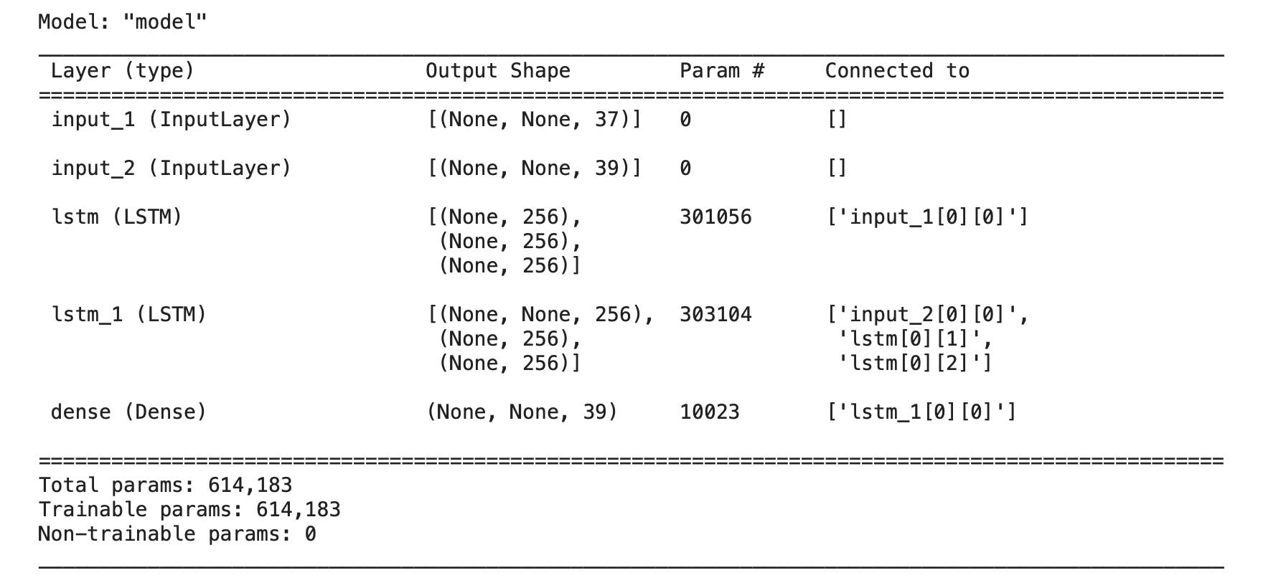
Auto-correction
Package: Autocorrect, TextBlob, Pycorrector
Build a spell checker with an LSTM model
generate wrong words - randomly delete/add/replace

Slide 28
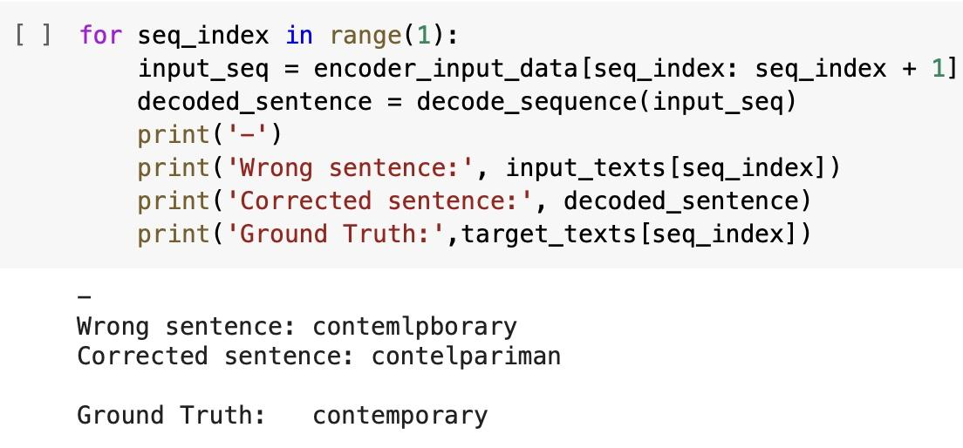
Auto-correction LSTM Result

Slide 29
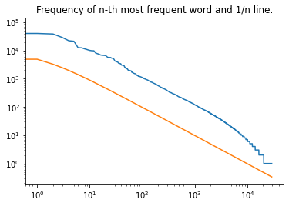
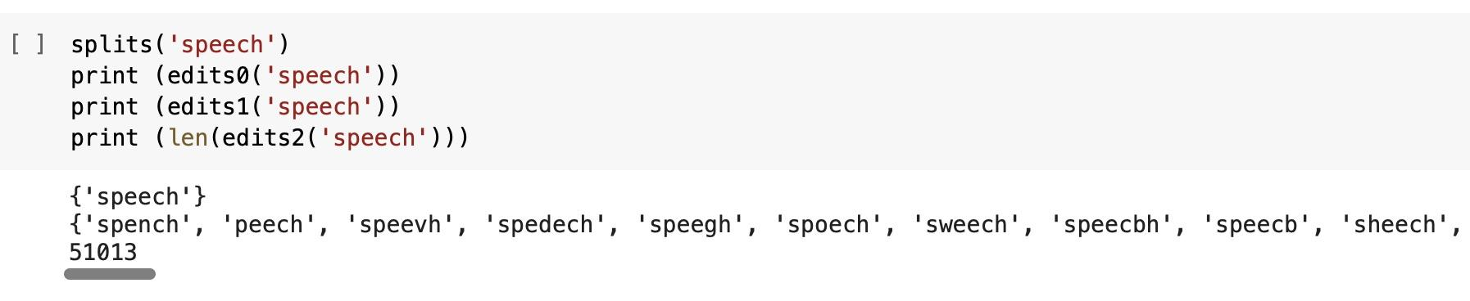
Auto-correction Bayesian
Bayesian with BOW
simplified version - avoid orders but keep frequencies
Theorem from Dr. George Zipf: in the case of large amounts of data, the probability of word occurrence is approximately the inverse of the word frequency ranking
Edit Distance (Levenshtein distance)
defined as the use of several insertions, deletion, swap, replace operation changes from one word to another

Slide 30
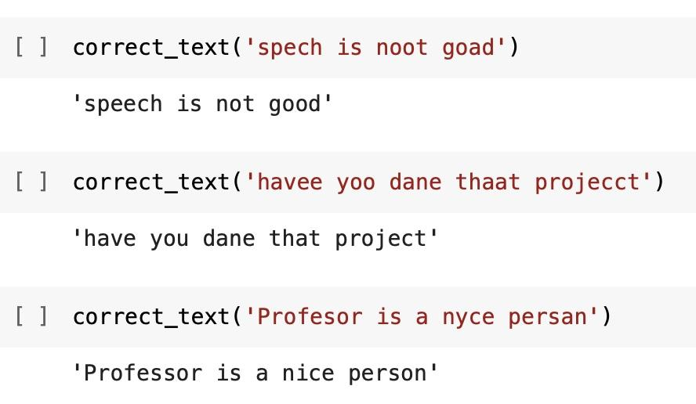
Auto-correction Bayesian Result

Slide 31
Conclusions
Auto-complete | Doc2vec & Trie | Easy to implement Simply list without ranking Huge size of model
 | Embedding match | Good results with any length Slow operation Require huge memory
 | LSTM | 3 layer LSTM performs best Efficient results Prediction depends on input length
 | NNLM & N-gram | It contains all the information that the first N-1 word can provide, and these words have strong constraints on the occurrence of the current word. It requires a considerable amount of training text to determine the parameters of the model. When N is large, the parameter space of the model is too large.
 | Text RNN with attention | Not intuitive enough interpretability is not good, especially when analyzing badcase intuitively give the contribution of each word to the result

Slide 32
Conclusions
Auto-correct | Mature English text auto-correction package: Autocorrect, TextBlob, Pycorrector | relatively mature easy to use
 | LSTM-based text auto-correction | needs to make negative samples brings high computational overhead the generalization ability is not strong very dependent on rich and large corpus
 | Auto-correction based on bag of words + Bayes theorem + edit distance | simple principle of the unsupervised model small computational overhead the larger the corpus, the better the effect stronger generalization ability

Slide 33
Thanks for watching

Slide 34
Reference
https://aclanthology.org/P16-2034.pdf
https://www.researchgate.net/publication/320653244_Enhanced_word_embedding_with_multiple_prototypes#pf2
https://en.wikipedia.org/wiki/Trie

